Slide 2
Global Document Audit Agenda
Audit Scope Review
Audit Objectives
Audit Flow
Document Hierarchy
Standard Requirements
Audit Results
Audit Closing Meeting and Report

Slide 3
Global Document Scope Review
Review Specifics of this Audit

Slide 4
Global Document Audit Objectives
Determine if documented global policies
and procedures meet Guide 65, ISO 17025,
ISO 17020, accreditor and UL Global Quality
Manual requirements
Determine if documented local procedures
meet UL Global Policy and Document
Control (00-QA-S0003) requirements
3) Review requirements for records generation,
storage, etc Global Records Policy (00-QA-P0026)
4) Support document harmonization efforts

Slide 5
Audit Flow- Methodology
Review Standards (ISO 17025, ISO 17020, Guide 65) for Requirements
Review Global Policies against
Std. Requirements
Review local SOP’s against Global Policies
Review issues and suggested owners with Global Policy/Process owner prior to generating any CARs (obs) and the closing meeting
There may be discussions throughout the audit with
Global Policy/Process Owners as well
as local document owners to clarify items, etc

Slide 6
Document Hierarchy and Document Types
The QMS Documentation pyramid illustrates the hierarchy of
quality documents. Document Control pertains to all levels within the pyramid.
Mission
Statement
Quality Policy
UL Global Quality Manual
Program Policies and Procedures
Functional Operating Procedures
Local, Regional, and Internal/External Technical Documents

Slide 7
Document Types
Policy Documents
High level documents that define requirements and overall responsibility
These are the vital few documents; approval usually at high levels (VP, etc)

Slide 8
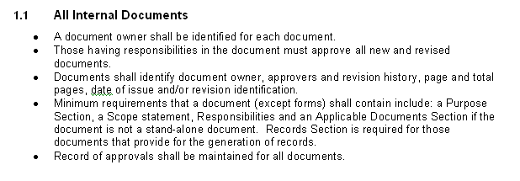
Document Types
Policy Documents
Example: from 00-QA-P0002

Slide 9
Document Types
Standard Operating Procedures (SOP)
Defines the lower level who, what, when and where…
  Who - which group specifically has responsibility
  What things they are responsible for
  When- time frames -- this could be frequency; under what circumstances
  Where – location or area of responsibility for example, responsible for their local site or area
  Includes records requirements
An SOP would not detail a step-by-step method on what needs to be accomplished.

Slide 10
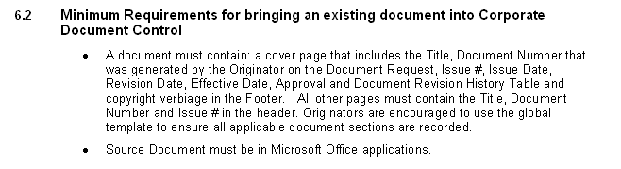
Document Types
Standard Operating Procedures (SOP)
Example: from 00-QA-S0003

Slide 11
Document Types
Work Instructions
Work instructions explain, step-by-step, how a task is performed. A Work Instruction is typically developed to give additional detail that is not provided by the procedures and policy documents that reside above it.
If additional guidance or aid is needed, these types of general helpful aids will be found in either a job aid or an internal guidance document.

Slide 12
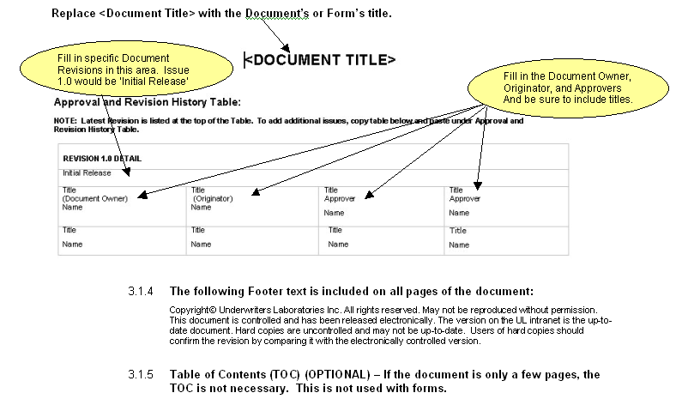
Document Types
Work Instructions
Example: from 00-QA-W0006

Slide 13
Standard Requirements
Use this slide to support audits where training/overview of requirements is needed
ISO 17025 Requirements
Guide 65 Requirements
ISO 17020 Requirements

Slide 14
Audit Results
In most cases observations will be generated
An audit report will be generated and posted
to IQA Web
Information from Global Document Audit will
feed into the Global Process Audit

Slide 15
Global Document Closing Meeting and Audit Report
Global and local document owners are invited to the meeting
Local CAR and Corporate CAR Adms. are invited to the meeting
Suggestions for improvement such as combining documents
  into a regional document or deleting because of duplication,
  will be included in the audit report summary
Open issues that are going to be followed up on in a global
process audit will be documented in the audit report summary
All findings will be reviewed and suggested owners discussed

